Slide 1



Nintendo Switch Game Data Analysis
View in Power BI
Last data refresh:
03/05/2025 16:44:30 UTC
Downloaded at:
06/05/2025 16:50:56 UTC

Slide 2

Start Screen
Notes:
shape
No alt text provided
shape
No alt text provided
shape
No alt text provided
shape
No alt text provided
shape
No alt text provided
shape
No alt text provided
shape
No alt text provided
shape
No alt text provided
shape
No alt text provided
shape
No alt text provided
actionButton
No alt text provided
image
No alt text provided
image
No alt text provided

Slide 3
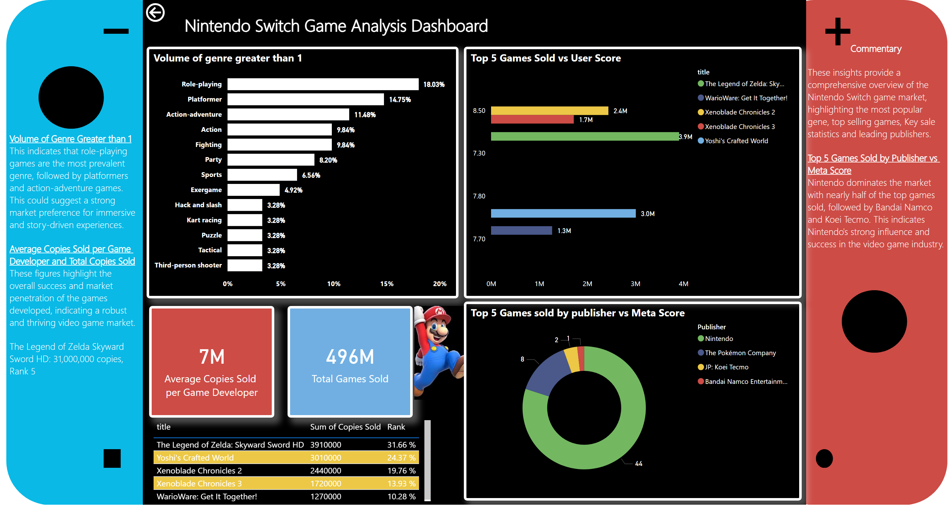
Dashboard
Notes:
shape
No alt text provided
shape
No alt text provided
shape
No alt text provided
shape
No alt text provided
shape
No alt text provided
shape
No alt text provided
shape
No alt text provided
shape
No alt text provided
shape
No alt text provided
shape
No alt text provided
textbox
No alt text provided
Volume of genre greater than 1
No alt text provided
card
No alt text provided
card
No alt text provided
textbox
No alt text provided
actionButton
No alt text provided
textbox
No alt text provided
Top 5 Games Sold vs User Score
No alt text provided
Top 5 Games sold by publisher vs Meta Score
No alt text provided
image
No alt text provided
AhpDecisionMakerE1C5D604D9ED4048B2F483846F3CDC24
No alt text provided

